Slide 1
Topic : Normal Force

Slide 2
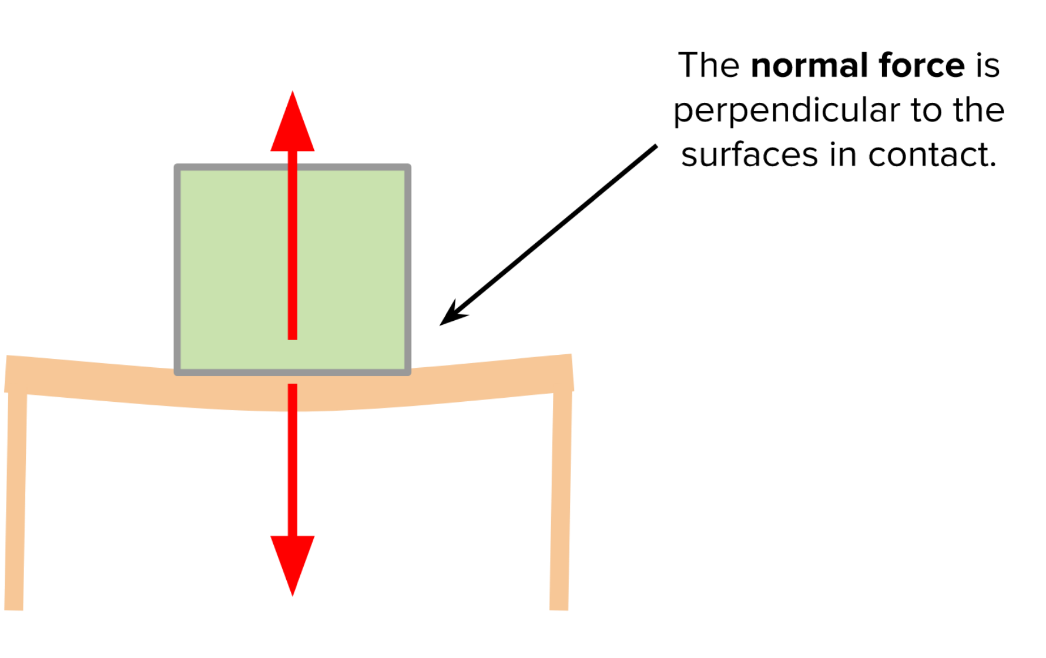
What is Normal Force ?
In mechanics, the normal force is the component of a contact force that is perpendicular to the surface that an object contacts.

Slide 3
Normal Force Normal force equal to Weight
The normal force is usually symbolized by N .
In many cases the normal force is simply equal to the weight of an object, but that's only when the normal force is the only thing counteracting the weight. That is not always true, and one should always be careful to calculate any force by applying Newton's second law.

Slide 4
Normal Force Can Normal Force be zero?
Normal force is never zero.
Normal force is a force that is equal in magnitude and acts opposite to the body in contact. One can only say that the resultant force acting on a body at rest is zero. ... But, the block doesn't because the table itself exerts a force that counteracts that gravitational force on the block.

Slide 5
Normal Force Equation and Example Expalanation
In a simple case such as an object resting upon a table, the normal force on the object is equal but in opposite direction to the gravitational force applied on the object (or the weight of the object).
That is, { N=mg}, where m is mass, and g is the gravitational field strength (about 9.81 m/s² on Earth).
The normal force here represents the force applied by the table against the object that prevents it from sinking through the table and requires that the table is sturdy enough to deliver this normal force without breaking.

Slide 6
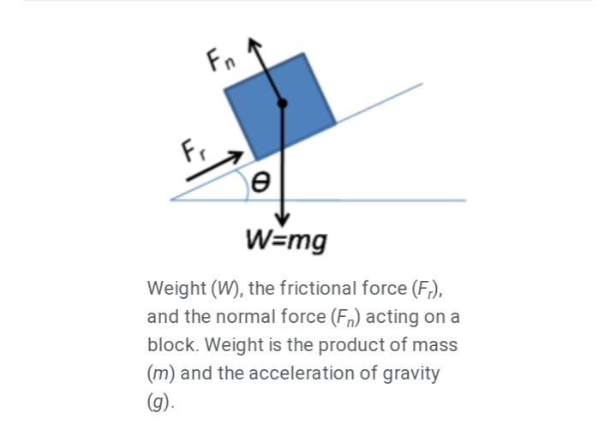
However, it is easy to assume that the normal force and weight are action-reaction force pairs (a common mistake). In this case, the normal force and weight need to be equal in magnitude to explain why there is no upward acceleration of the object.

Slide 7
Normal Explanation
Where an object rests on an incline, the normal force is perpendicular to the plane the object rests on. Still, the normal force will be as large as necessary to prevent sinking through the surface, presuming the surface is sturdy enough. The strength of the force can be calculated as: F=mg cos
Where N is the normal force, m is the mass of the object, g is the gravitational field strength, and θ is the angle of the inclined surface measured from the horizontal.
The normal force is one of the several forces which act on the object. In the simple situations so far considered, the most important other forces acting on it is force of gravity.

Slide 8
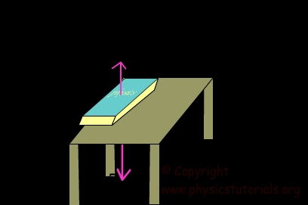
Example
For example, if a book is resting upon a surface, then the surface is exerting an upward force upon the book in order to support the weight of the book.

